Slide 1

Rapid Closure of Lingering Off-Site Plume Remediation Program in Residential Neighborhood using Horizontal Air Sparge and Soil Vapor Extraction Wells
Narayanan Raghupathi, P.E. (AMEC Environment & Infrastructure), Tallahassee, Florida; Sequino, Mike (Directional Technologies, Inc.), North Haven, Connecticut); Angela R. Finney (AMEC Environment & Infrastructure), Tallahassee, Florida

Slide 2
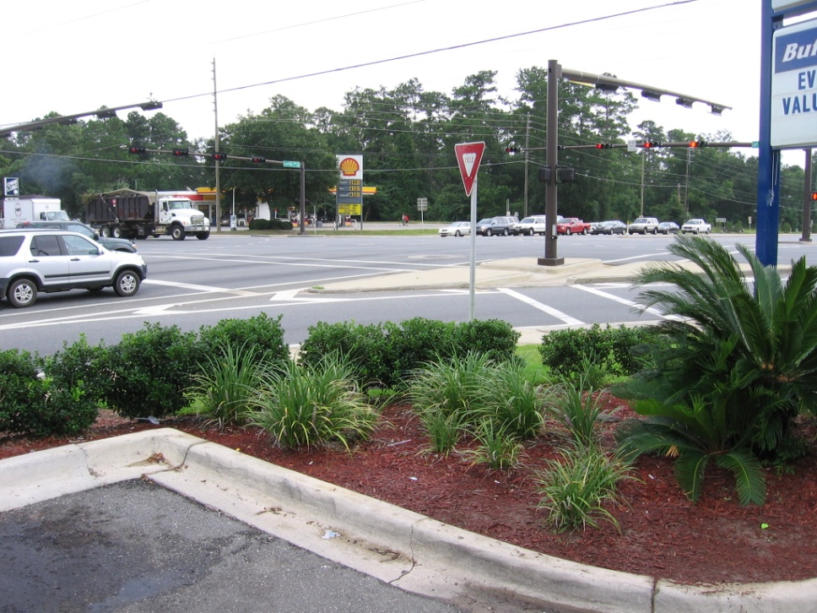
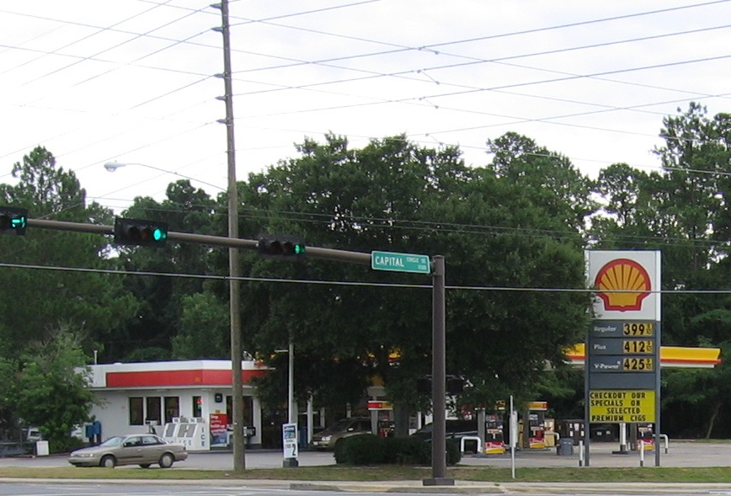
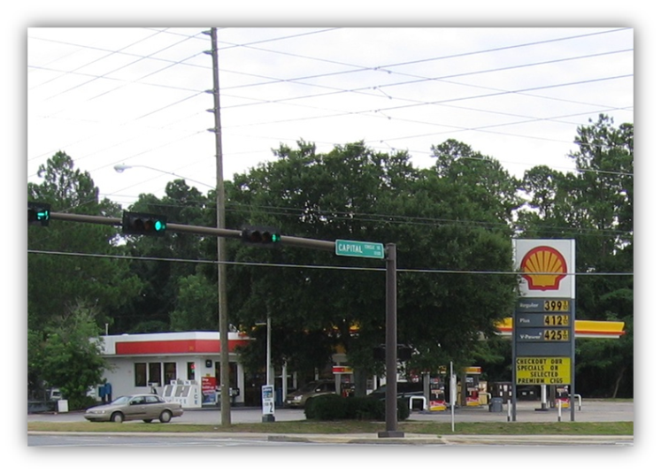
Site Location

Slide 3
Site History
Active gas station
Located at intersection of Hwy 319 and Hwy-27 in Tallahassee, Florida
1986- Approximately 1,000 gallons of premium unleaded gas leaked from an UST
Cleanup being conducted under FDEP Preapproval Program (Robert Brown, FDEP Site Manager)
1995- Installed groundwater recovery and AS/SVE systems (Delta, Inc.)

Slide 4
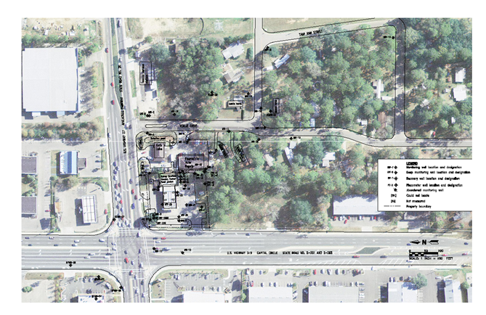
Site Map

Slide 5
Site Assessment
Site Geology consists of sandy clay to clayey sand and grading to fine silty sand at 40 ft bls.
Depth to water – 41 feet bls
Soil plume – 9,620 square feet (15 to 30 ft bls)
Groundwater plume – 46,722 square feet
COCs – VOCs, PAHs and TRPH
Highest Total BTEX – 11,720 (MW-20R2)
Down gradient contamination migration

Slide 6
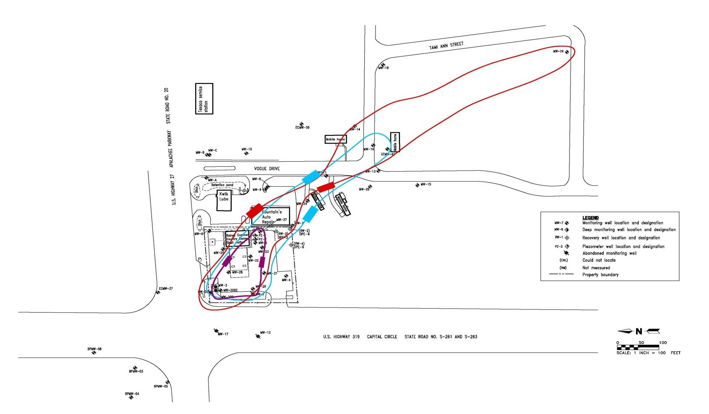
Baseline Groundwater Plume

Slide 7
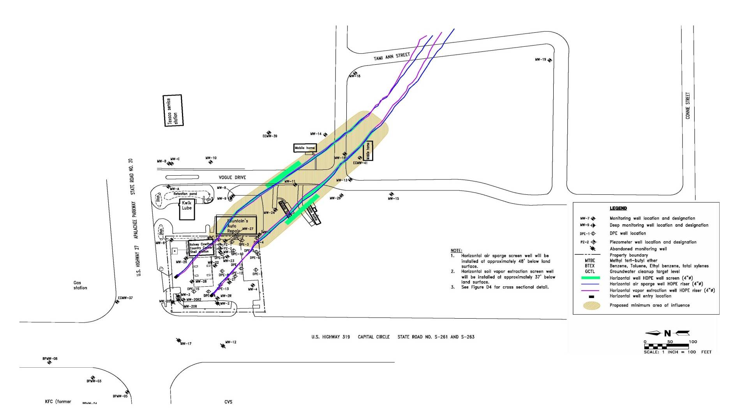
Down Gradient Horizontal AS and SVE Layout

Slide 8
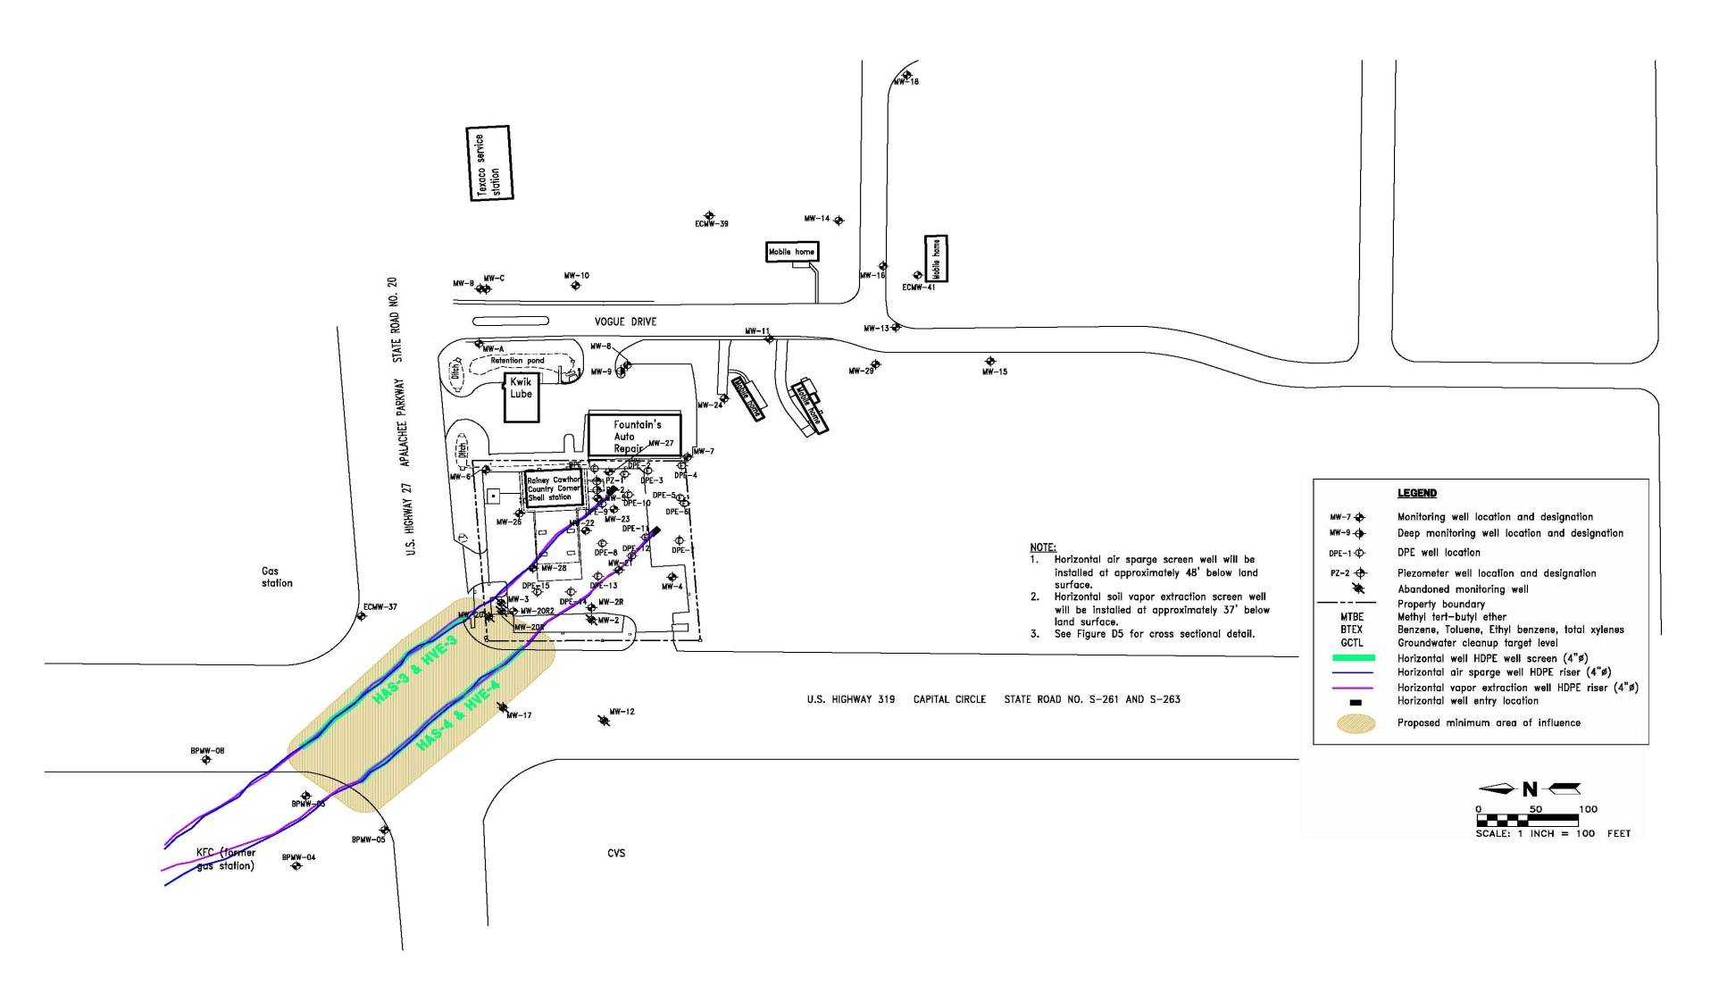
Up Gradient Horizontal AS and SVE Well Layout

Slide 9
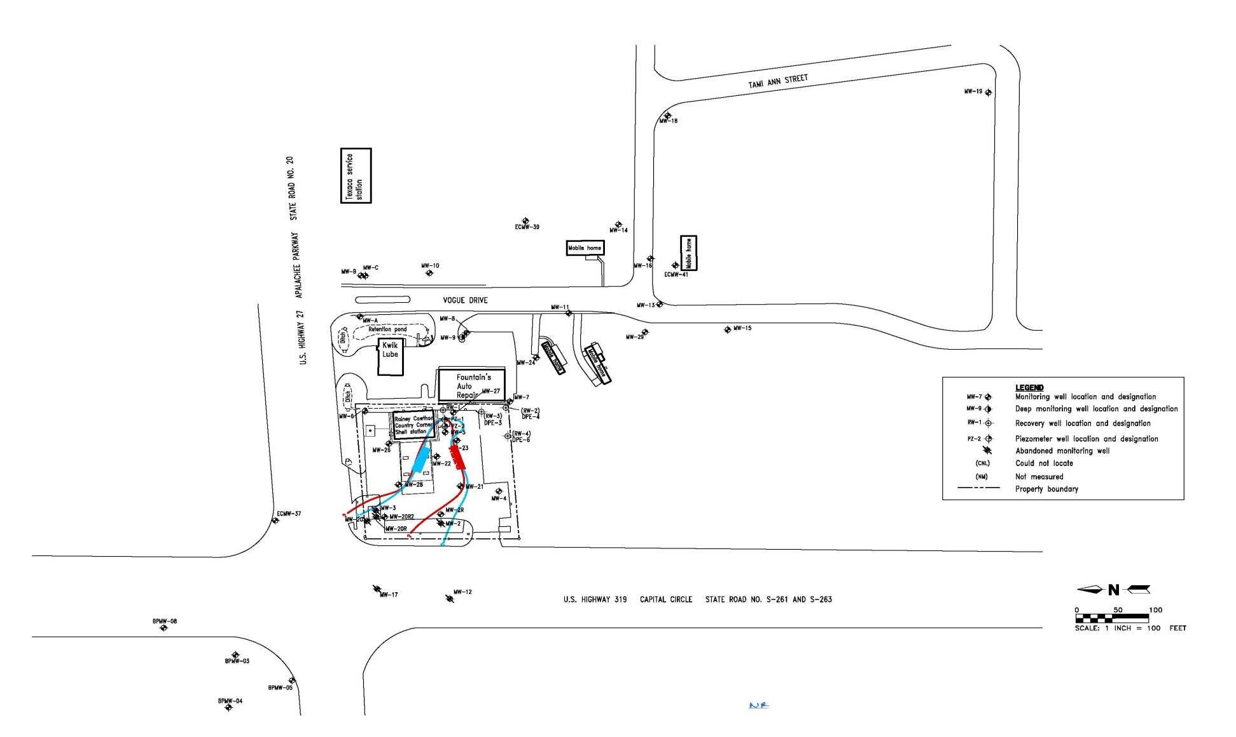
Current Groundwater Plume

Slide 10
Horizontal Well Screen Design
Design specifies the open area of the well screen that will allow uniform flow of fluid (e.g., air) into or out of the formation
Numerical model uses iterative calculation process to generate key mechanical parameters:
  Pressure along the screen
  Flow through the slotted screen pipe
  Injection or extraction rate of in-situ treatment fluids

Slide 13
Horizontal Well Screen Design
Flow of the air into the aquifer or water-bearing unit surrounding the horizontal screen is governed by equations related to Darcy’s Law and the Laplace Equations for mass balance
Air extraction follows the principles of mass conservation for isothermal gas in porous media as described by various forms of the Richards equation. The relative permeability of the soil gas is related to water saturation and head by the van Genuchten equations. The key relationships are described by Huyakorn and Pinder

Slide 16
System Installation
Eight horizontal wells installed in September and October 2008 to address hydrocarbon impact in sand and silt soils
Four horizontal air sparge well screens were installed at depths of 47 to 48 feet below ground surface
One horizontal soil vapor extraction screen was installed above each of the horizontal air sparge screens, at depths of 35 to 37 feet below ground surfac
Two of the well pairs were installed in the southwestward direction and the other two pairs were installed in the northeastward direction

Slide 19
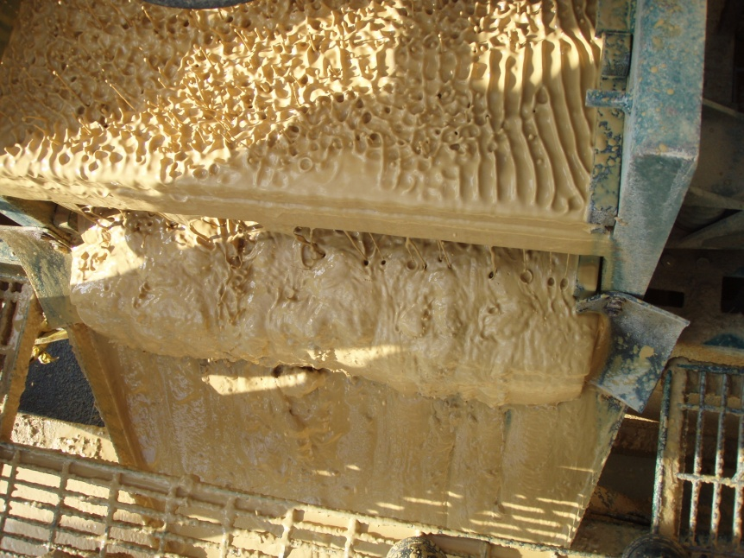
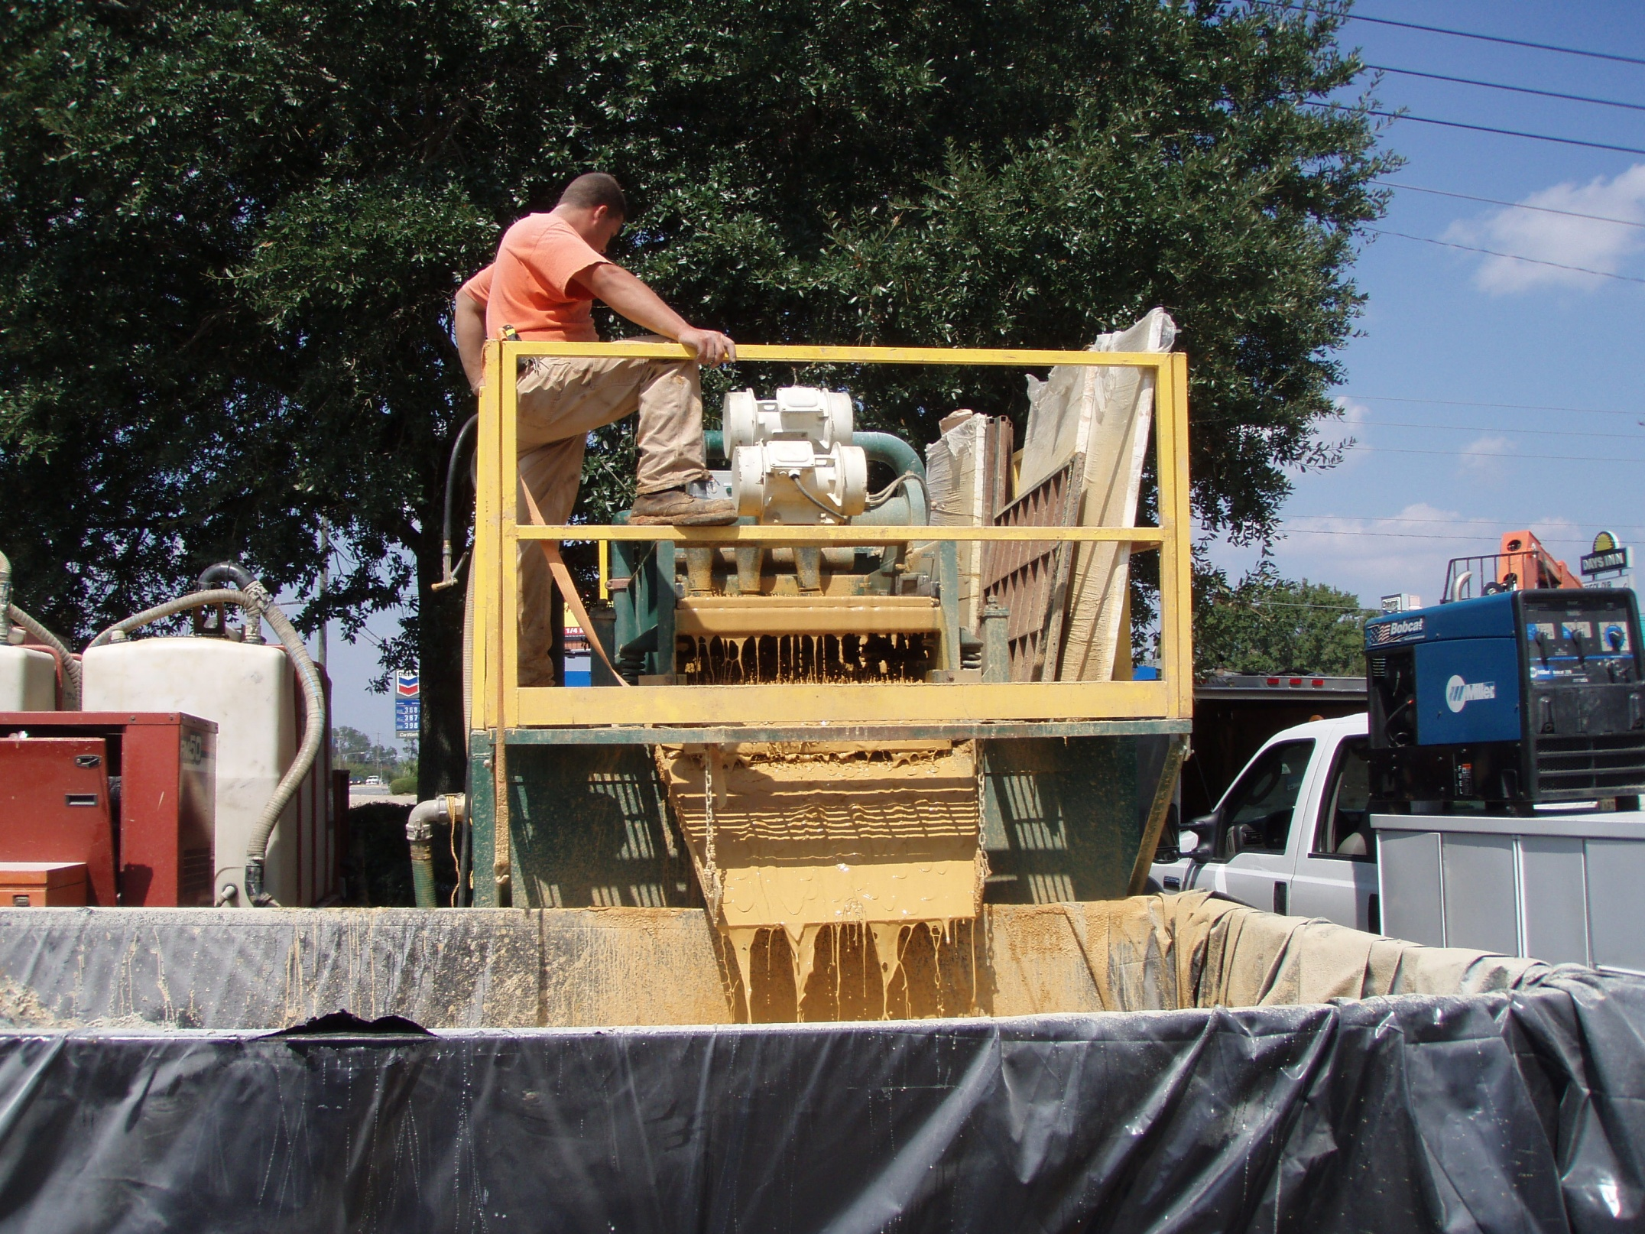
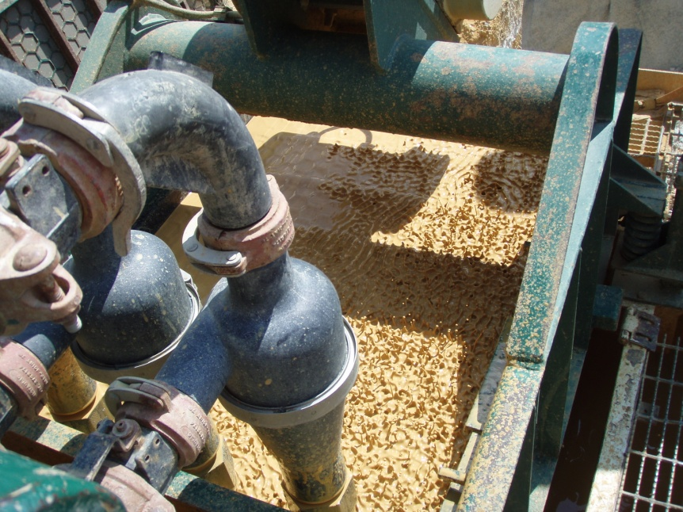
Drilling Fluids
Management
Flowing sands produced high volume of solid returns
Mud recycler separates sand/silt cuttings from fluid returns

Slide 20
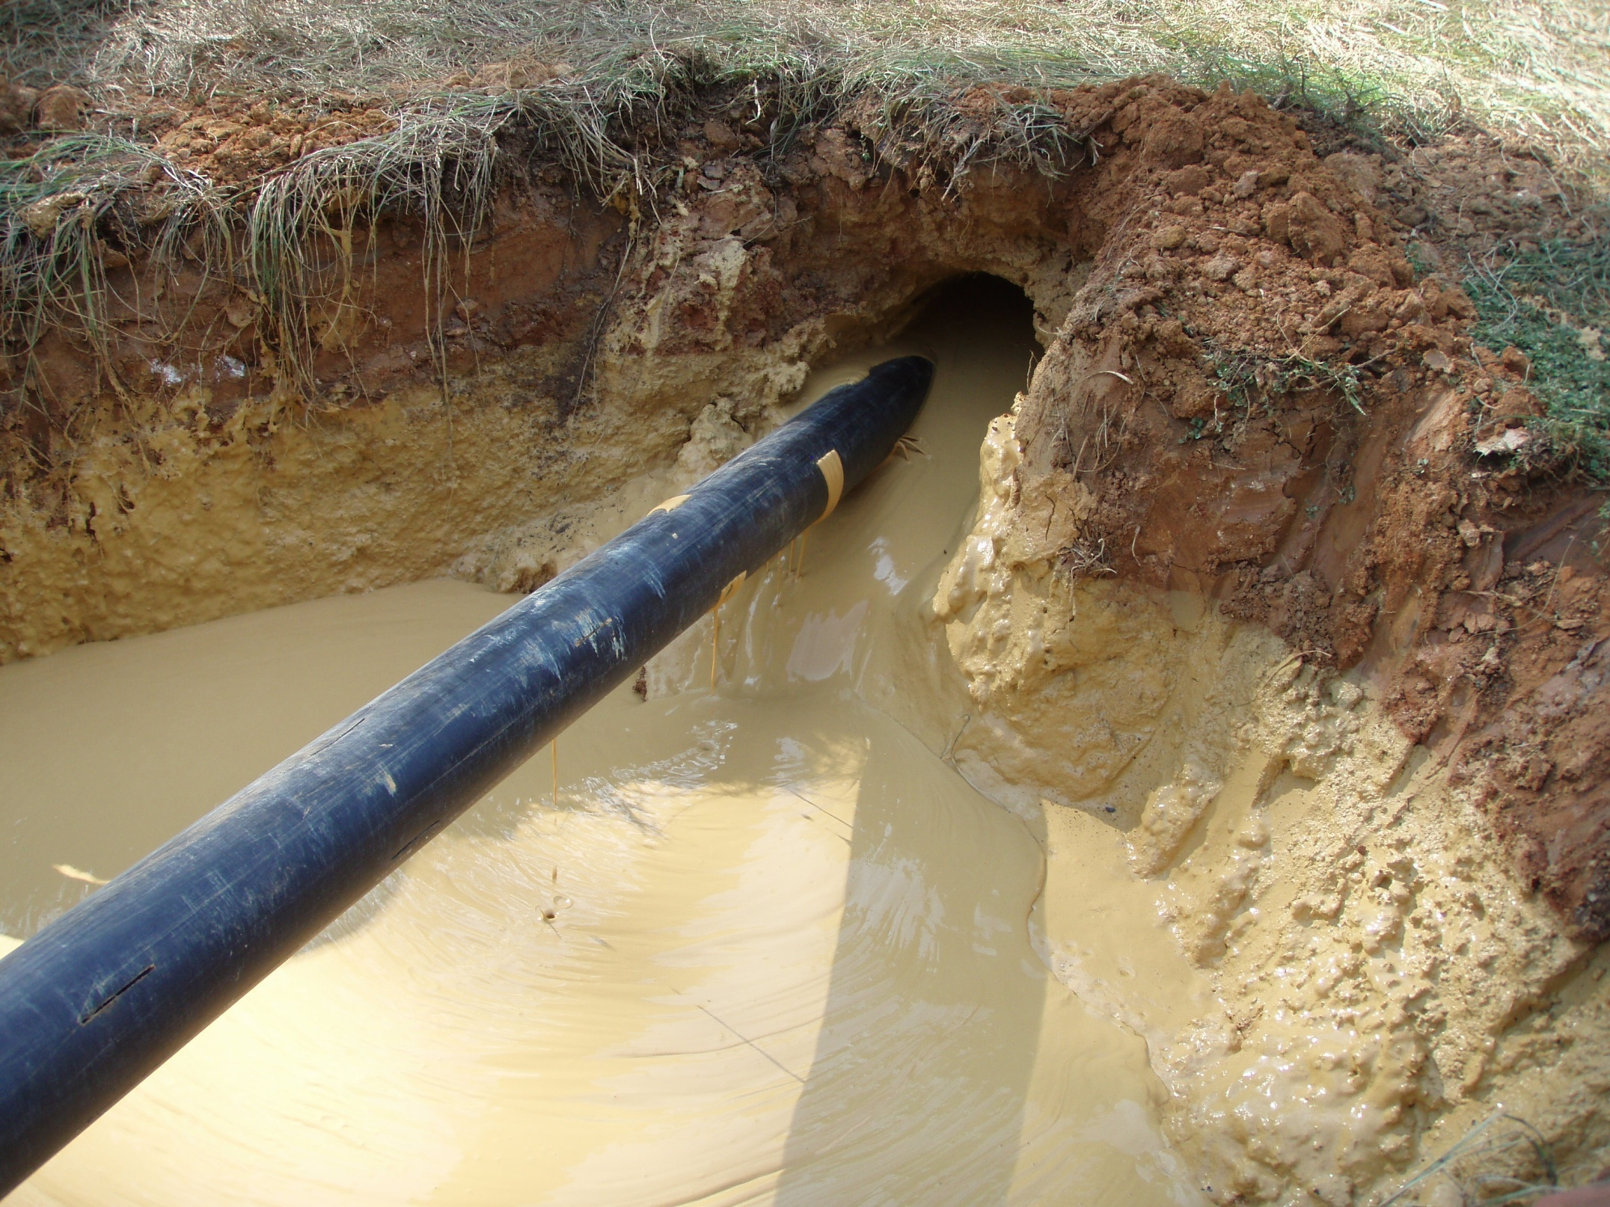
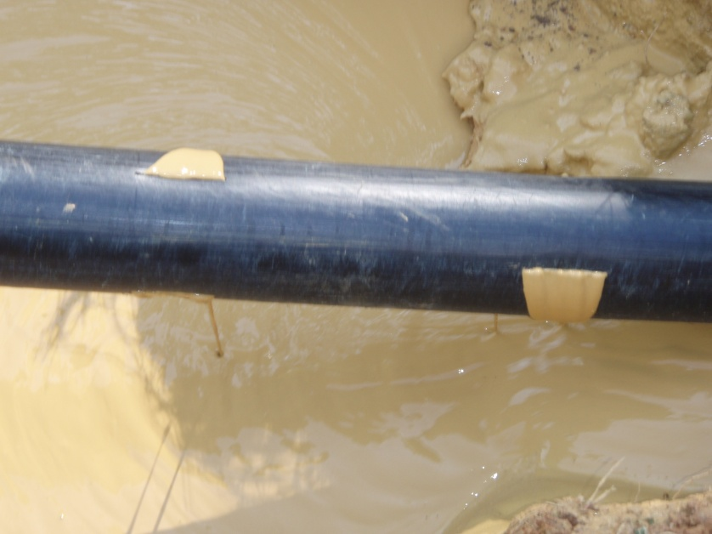
Air Sparge Screen
Longitudinally slotted
0.27% average open area
1.0” average slot length
0.1” slot width

Slide 21
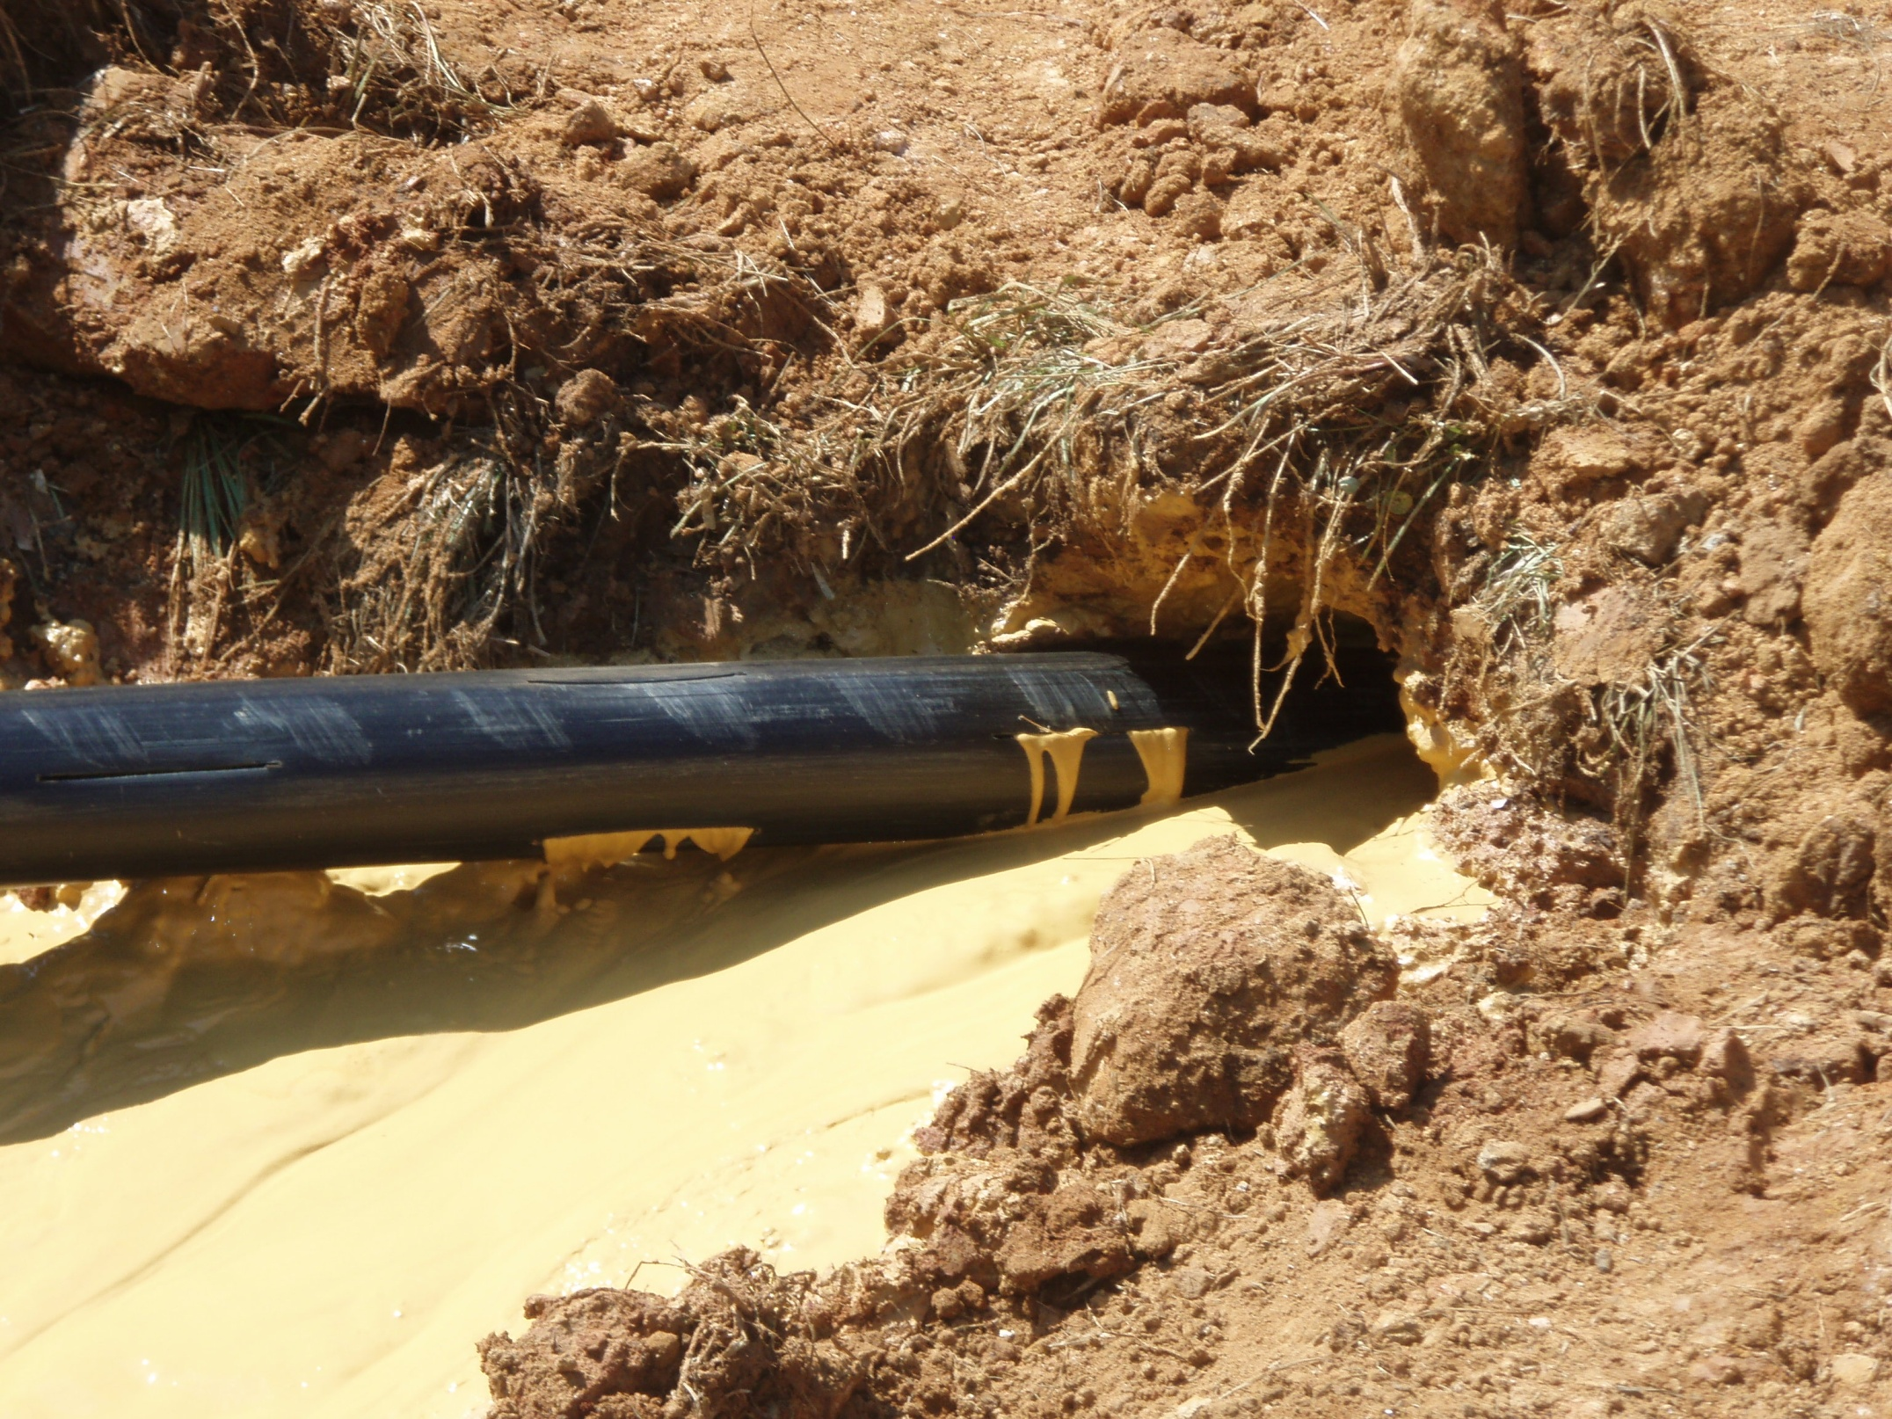
Soil Vapor Extraction Screen
Longitudinally slotted
1.01% average open area
3.7” average slot length
0.1” slot width

Slide 22
System Performance
Four key monitoring wells MW-16, MW-20R2, MW-22, and MW-28 were selected for monitoring of remedial progress at the site. The BTEX and MTBE concentrations are used to evaluate the achievement of milestones.
The total worst case emissions rate from the SVE and MPE system was 2.67 pounds/day, which is below the State of Florida regulatory limit of 13.7 lbs/day

Slide 23
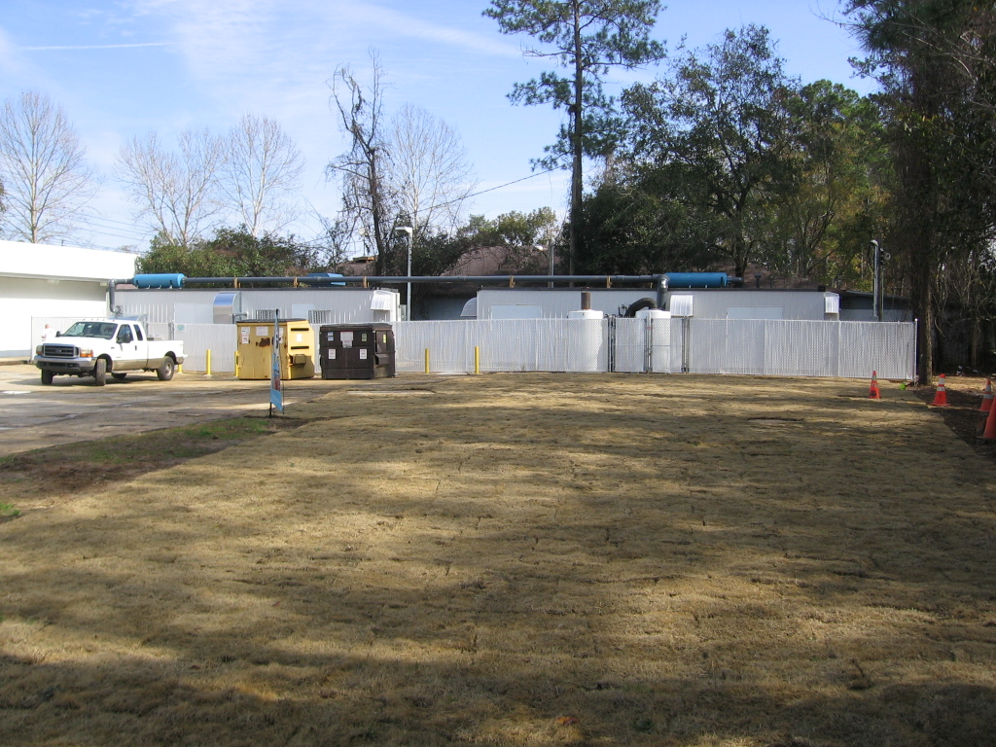
AS/SVE and MPE System

Slide 24
Cleanup Progress Evaluation
Monitoring Well ID | Designation | Baseline BTEX (µg/l) Nov 2008 | Year 2, 1st Qtrly BTEX (µg/l) July 2010 | % Reduction from Baseline
MW-16 | Down gradient | 2,114 | 0.99 | 99.99
MW-20R2 | Source area | 11,720 | 107 | 99.08
MW-22 | Source area | 11,000 | 0.32 | 99.99
MW-28 | Source area | 583 | BDL | 99.99
Totals |  | 25,417 | 108.31 | 99.57
Monitoring Well ID | Designation | Baseline MTBE (µg/l) Nov 2008 | Year 2, 1st Qtrly MTBE (µg/l) July 2010 | % Reduction from Baseline
MW-16 | Down gradient | 37 | 4.2 | 92.7
MW-20R2 | Source area | 590 | 87 | 76.27
MW-22 | Source area | 260 | 13 | 81.53
MW-28 | Source area | 140 | 2 | 98.71
Totals |  | 1,027 | 106.2 | 89.65

Slide 25
System Performance
Within the five quarters of system operation, the VOC concentrations have declined by approximately 98 percent, MTBE (81 percent), PAHs (98 percent), and TRPH (99 percent) since system startup, based on data from the four primary monitoring wells.
After 11 years of operation of a series of vertical well systems that failed to thwart down-gradient migration of groundwater contamination, the horizontal well system achieved site objectives within 2 years of operation, reducing all regulated compounds were reduced below regulatory limits (SCTLs and GCTLs)

Slide 28
Clean-Up Summary
Target Contaminant concentrations below NAM
PAHs below GCTLs
BTEX Plume Area – 6,500 sq. ft
MTBE Plume Area – 7,000 sq. ft
BTEX – 99 percent reduction
MTBE – 90 percent reduction

Slide 29
Project Summary
Successfully installed horizontal AS and SVE wells (Mike Sequino, Directional Technologies)
Horizontal AS/SVE wells are effective in reducing contaminant concentrations.
Achieved even air flow through the length of the horizontal well screens.
MACTEC Project Manager, Angela Finney, successfully worked with FDEP, property owners, and merchants.
Completed project on time and budget.

Slide 30
QUESTIONS

